Slide 1

EXPLORATORY DATA ANALYSIS On DATA SCIENCE COURSE IN COURSERA

Slide 2
Agenda
What is COURSERA
What we have scrapped
Web Scraping
Information about collection Data
EXPLORATORY DATA ANALYSIS
a. Data Cleaning Steps
b. Data Manipulation Steps

Slide 3
Presented by:
Noah Shanthi Raj
Sandeep kattupalli

Slide 4

What is coursera
Coursera is a global online learning platform that offers anyone, anywhere, access to online courses and degrees from leading universities and companies.

Slide 5
What we have scrapped:
Courses
Company offering courses
Rating
Reviews
Credits
Time taken to complete the course
Type of courses
Skill gained from the courses

Slide 6
Imported libraries
Requests
BeautifulSoup
Pandas
Seaborn
Matplotlib
Wordcloud

Slide 7
Pandas
Matplotlib
Pandas is used for manipulation of given data set and analysis.
.
Matplotlib is a popular Python library used for creating static, animated, and interactive visualizations.
Seaborn
Seaborn is a popular Python data visualization library built on top of matplotlib.
Requests
Using requests library, we can fetch the content from the URL
BeautifulSoup
Beautiful soup library helps to parse it and fetch the details the way we want. You can use a beautiful soup library to fetch data using Html tag, class, id, css selector and many more ways.

Slide 8
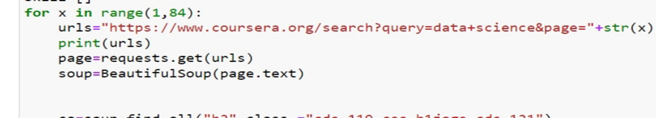
Data Collection Process:
First we extract every link of Each coursera using courses with help of Requests, BS4
Use it for both static web pages and dynamic web pages .
After Extract every data, create a Data Frame using list and save Data Frame to CSV file
or excel file

Slide 9
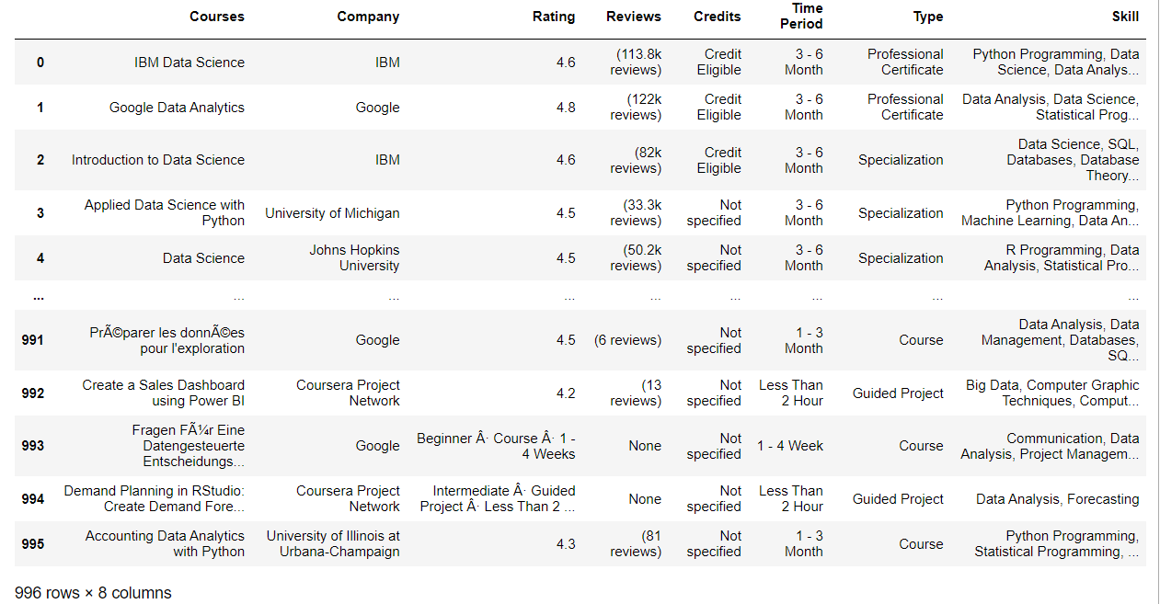
Data Frame Overview

Slide 10
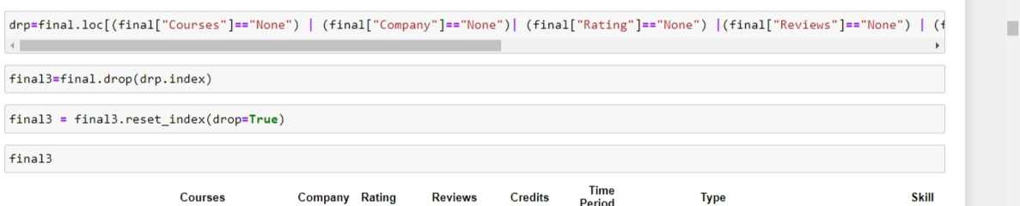

Data Cleaning
Removing Duplicates

Slide 11
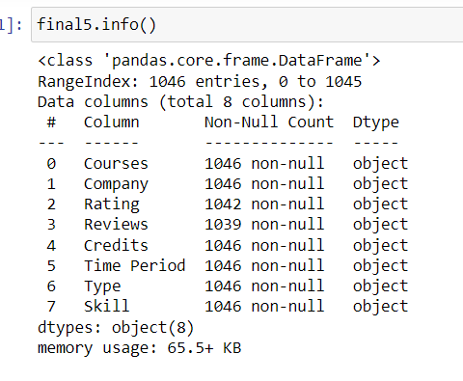
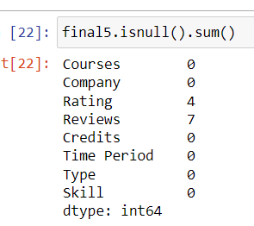
Data info
Totla 8 columns
As the null values are few we dropped them

Slide 12
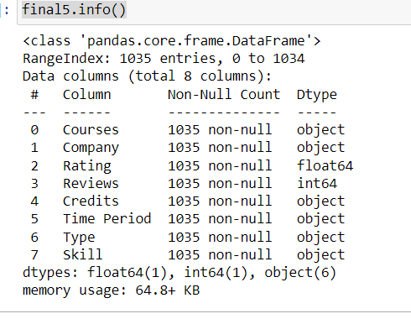
Converted rating and reviews to float and int respectively

Slide 13
Data Analysis

Slide 14
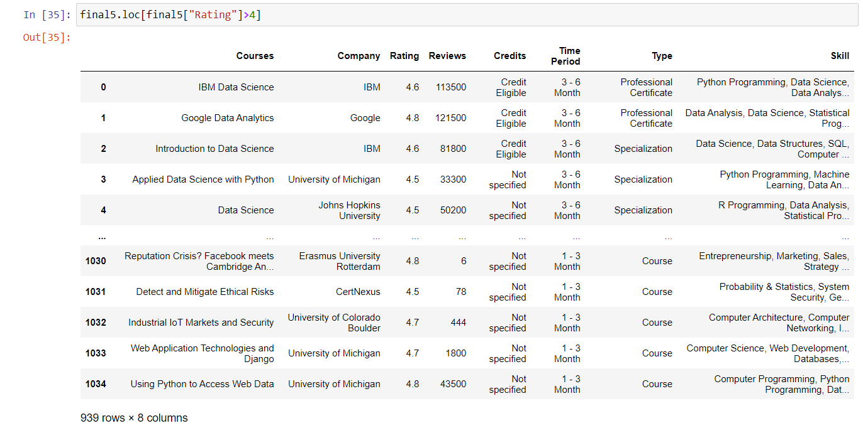
There are 939 courses that have ratings above 4

Slide 15
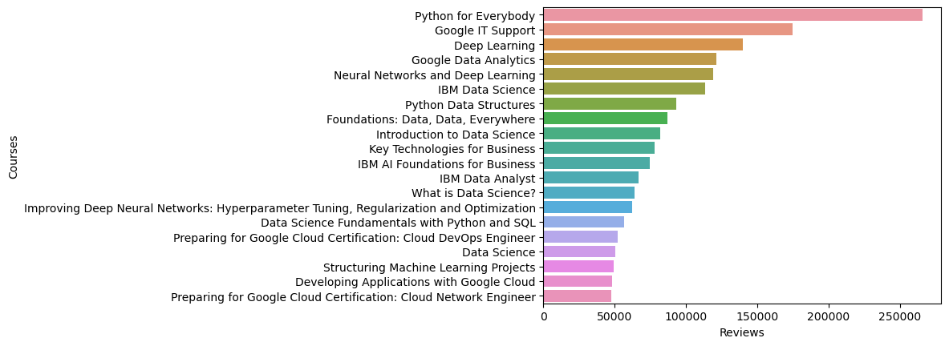
Visual representation of top 20 courses with highest reviews

Slide 16
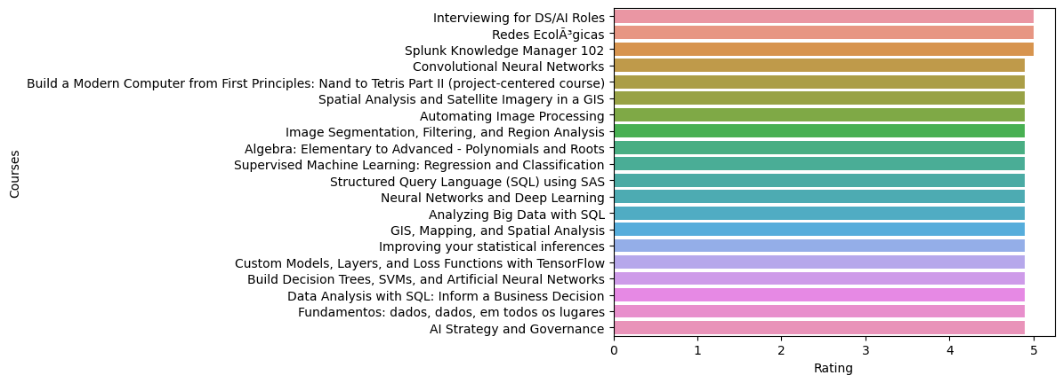
Visual representation of top 20 courses with highest ratings

Slide 17
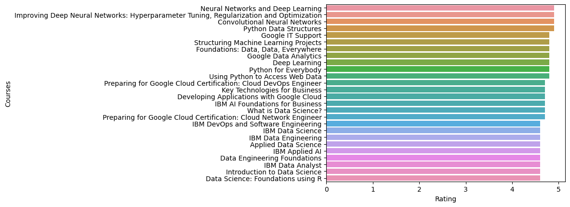
Visual representation of courses with with rating>4.5 and reviews > 40000 with respect to rating

Slide 18
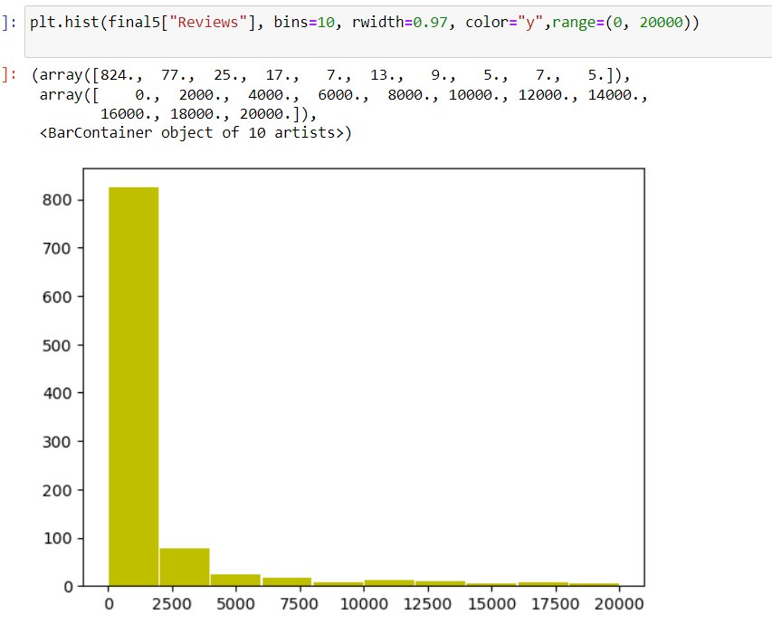
There are about 824 courses whose reviews is above 0 to 2000, and 77 courses whoes reviews in between 2000 to 4000 and 25 courses whoes reviews is between 4000 to 6000 and so on

Slide 19
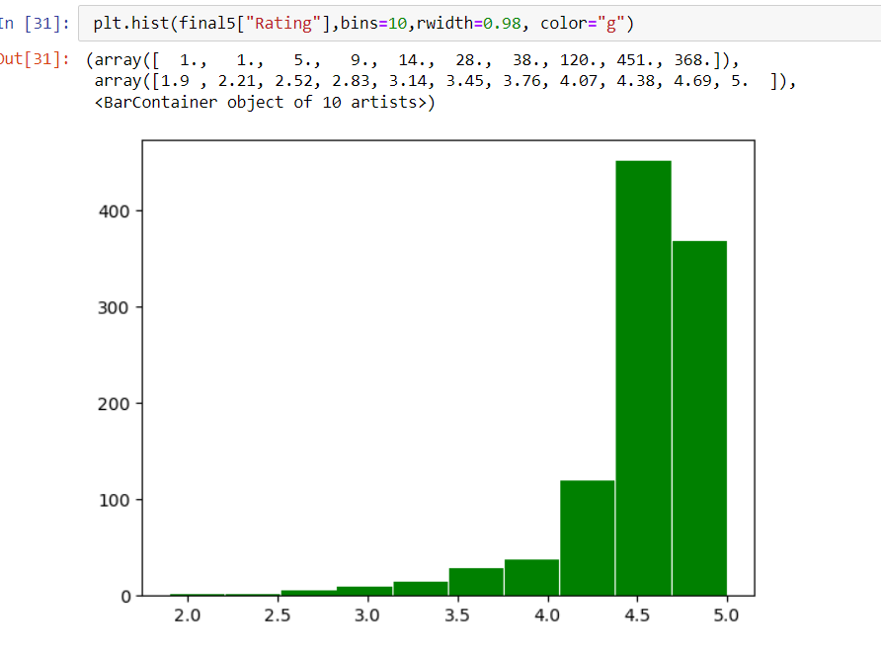
There are 451 courses whoes ratings are 4.38 to 4.69 and 368 courses whoes ratings are 4.69 to 5 and so on

Slide 20
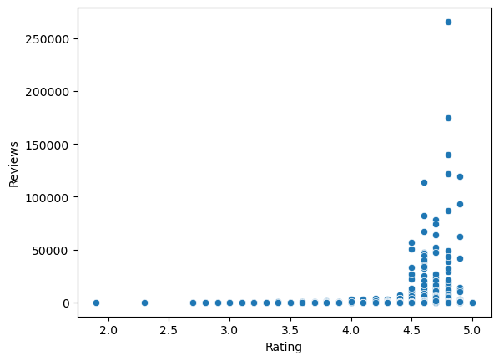
There are more courses that are having rating from 4.5 to 4.9 and have reviews 0 to 100000

Slide 21
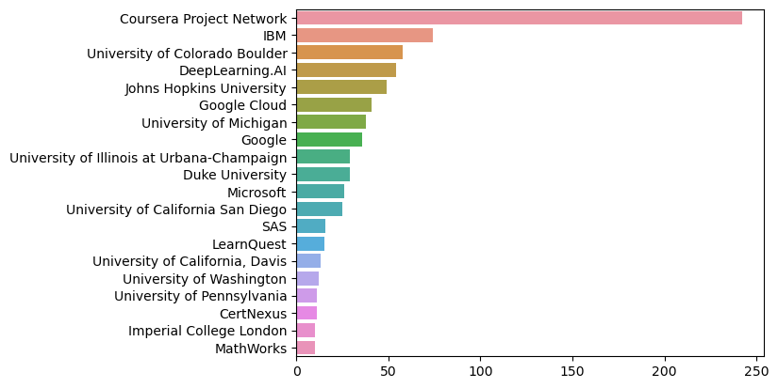
These are the top 20 companies that have are offering 1 or more courses

Slide 22
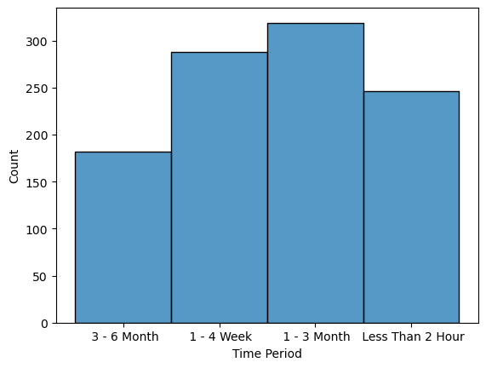
There are more than 300 courses that has time period of 1-3 Months and upto 280 courses that has time period of 1-4 week and so on

Slide 23
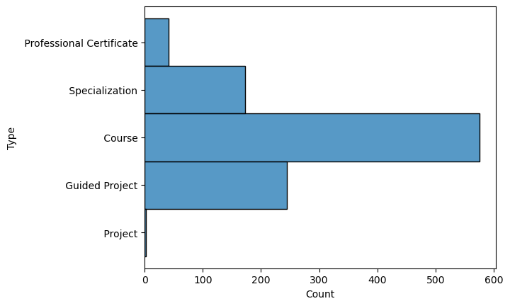
There are about 580 courses that is have course type as course and there are about 260 courses that have course type as guided project

Slide 24
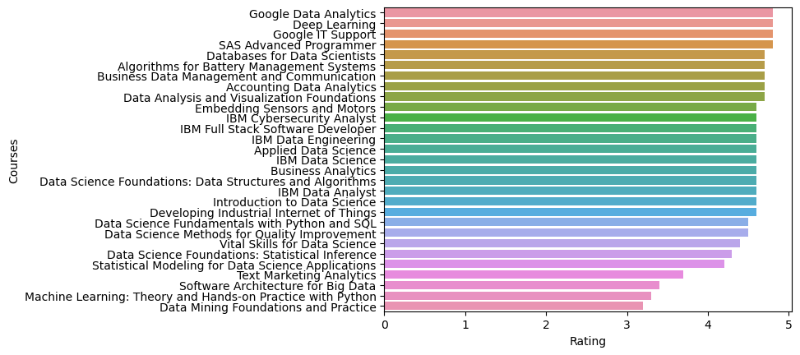
These are all the coureses that have credits and arranged in descending order with referance to rating

Slide 25
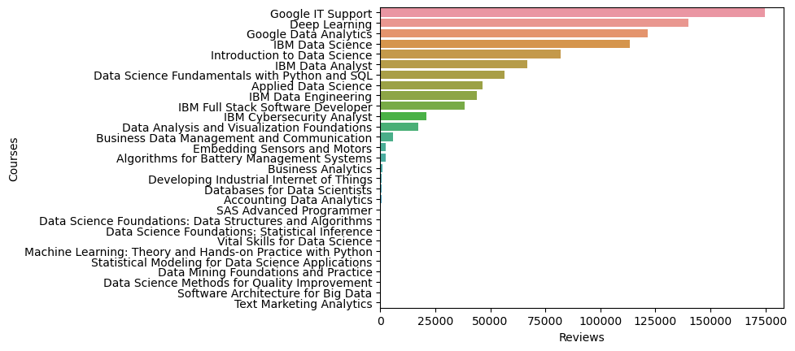
These are all the courses that have credits and arranged in desceding order with reference to reviews

Slide 26
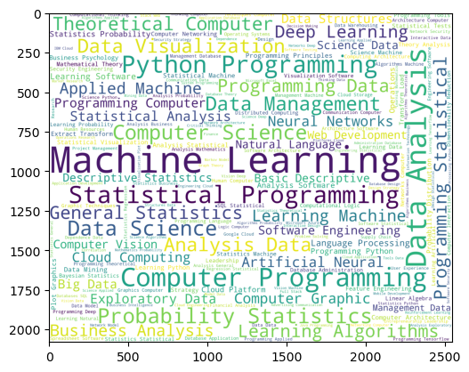
Word colud of the unique skills from all the courses

Slide 27
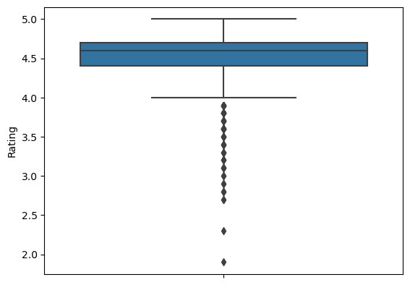
There are few ratings, which are outliers, that are below 4.0

Slide 28
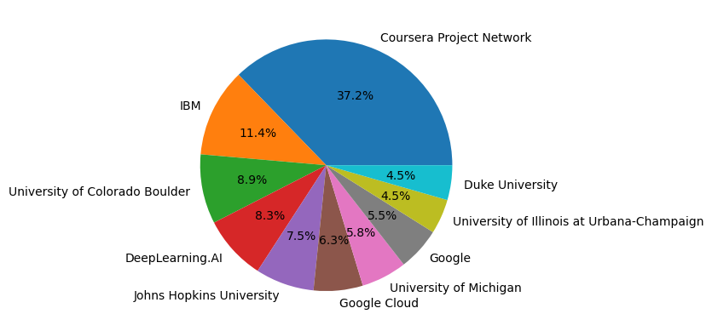
These are the top 10 company that are offering more than 1 coursesx

Slide 29
Thank you! Every one

